Slide 1
Software Quality Analysis
Notes:
Hi Everybody!! “I am Vishwas. I work on HCL’s Digital and Analytics Solutions team with Sanjeet. I worked closely with Alain, Daren and Shailendra to understand the requirement and the concerns that KPMG has been having with the development of Clara and we have put together the solution proposal which I will be walking you all through ”I will walk you through the solution outlined in the deck.

Slide 2






Agenda
01
04
HCL’s Understanding & Project Scope
Engagement Model
02
05
Methodology, Approach and Deliverables
Q&A
03
06
Timelines and Team Structure
Appendix
Notes:
I want to go over the below agenda topics. Feel free to stop me anytime for any questions. We also have a Q and A session at the end.

Slide 3
HCL’s Understanding of Requirements
Clara is KPMG audit management application with key features highlighted as below :
Global product with advanced data analytics capabilities.
It is a bespoke workflow engine.
Brings consistency to the KPMG audit process worldwide.
Current limited rollout used by 150 members firms successfully.
Estimated volume of global audits is ~300K post full roll out.
Development of this product involves significant effort:
Onsite – offshore model across 300 developers and 12 sprint teams.
Approximately 2 million lines of code.
Evolving towards true agile methodology.
Implementation of CICD process.
Fortify is used for static security scanning (code review)
There is no other code quality analysis tool being used today.
Current product release schedule is spread across three quarters
Feb, May, Sep.
May release is deemed as major scheduled release.
Issues and Concerns identified by KPMG are as below :
Robustness of application owning to quality of code.
Additional enhancements causing data loss.
Pending open defects (~2000) including ~400 open critical defects.
Notes:
Firstly I would like to briefly go over our understanding so far about the application and the concerns or issues that you are facing.
Clara is an audit management application which brings consistency to the KPMG audit process worldwide. It is a global product with advanced data analytics capabilities and a bespoke workflow engine. It is a complex application with approximately over 2million lines of code, being developed across 122 sprint teams with about 300 developers in an Onsite- Offshore model. The implementation of CICD pipeline for this project is evolving , while following a true agile process is also maturing. Current limited rollout is used by 150 member firms successfully and post full rollout would have a volume of approx. 300k audits. The release schedule typically has 3 releases in Feb, May and September and the may release has been major release so far.
Some of the major concerns facing the application is the quality of code hampering the stability of the application. There are approximately 2000 open defects out of which 400 are critical defects. One of the major defects causing an extreme concern is the data loss which was a result of a new data purge feature that was added. This brings us to the scope of the project . Please let me know if you have any questions or anything you need to add or else I will move to the next slide.

Slide 4
Project Scope
Performing code and design review of KPMG’s application Clara.
Two Phased approach:
One-time review of application code and design with another round of detailed analysis
Ongoing Code and design review support throughout the development process.
Enable
Automatic
Code Analysis
Perform
Design
Review
Recommend
Code
Quality Enhancement Measures
Publish Relevant
Metrics
Notes:
The whole Intent behind this engagement is to ensure KPMG gets right standard based code that follows the right design principles agreed upon with the vendor and we are here to ensure that we do it in the right way. We would do this as a 2 phased approach:
First one being – as a One Time Activity.
Second one as an Ongoing activity that ensures consistent coding practices through out the development process.

Slide 5
How we engage
ENERGIZE
EXTRACT
ANALYZE
CRAFT
HCL Organizes a team of experts
Includes Architects , developers & tool experts
Discussions
Environment Access and Tools Setup
Customize Rules
Remove False Positives
Analyze Findings
Log issues
Guidance on course correction
Notes:
HCL proposes a standard approach for any engagement that is similar to yours. There are 4 stages in that approach.
Energize – is a stage where we get the right teams onboarded,get your involvement and commitment from your resources on calendars. Setting up a schedule of the meetings, ensure we have access to the environment and any documentation that is required. Basically in the stage we make sure that the pre requisites are met to ensure a seamless beginning of the next stage which is
Extract stage-during this stage we talk to you, do our due diligence, look at the artifacts, going through the code structure and basically gathering as much information as possible to make the analyse stage possible.
In the Analyze stage we go through the reports generated as a result of the run of all the tools for code analysis which we will report back to you in the form of JIRA tickets or reports depending on which tool we are using, in the Craft phase.
We can go into a little more detail of each phase.

Slide 6
Energize Phase Week 1
Entry Criteria
Key Activities
Exit Criteria
Meetings scheduled with the stakeholders and the team.
Access to Project Manager to enable planning for the engagement.
Access to Application architect, Business Analyst and other SMEs for Clara to plan the knowledge sharing sessions.
Conclusion of project planning Meetings.
Agreed plan of knowledge sharing sessions.
Agreed Project Plan, Communication, Stakeholder Engagement Plan
Define a plan for setup of Automatic Code Analysis.
Define a plan to incorporate Manual Review process in the development process.
Project Plan
Knowledge Sharing Schedule
Deliverables
Project Sponsor
Project Manager
KPMG Stakeholders Requirement
Notes:
The first week of the engagement wil be the Energize phase and the duration of this phase will be one week. During this phase we will connect with various stakeholders of the application like the Project Manager, Project Sponsor, application architect , Functional SMEs etc. The agenda will be to define a definitive plan to set up and execute the code reviews.
By the end of this phase we should have a completed and agreed Project Plan ,a schedule for knowledge sharing of the application and a communication plan.

Slide 7
Extract Phase Week 2 – Week 3
Entry Criteria
Key Activities
Exit Criteria
Conclusion of project planning Meetings.
Agreed plan of knowledge sharing sessions.
Agreed Project Plan, Communication, Stakeholder Engagement Plan
Knowledge Sharing Sessions.
High Level Application Demo.
Knowledge sharing sessions completed.
Tools Setup Completed
Design Walkthrough and Code Walkthrough completed.
Understanding of the current features being developed, backlog items and the features to be developed in the future.
Understand the features being developed and other items being addressed in the current release cycle.
Environment Access
Tools Setup
Tool Setup
Deliverables
Application Architect
Application developers
Business Analyst
Project Manager
KPMG Stakeholders Requirement
Notes:
Week2 to Week 3 will be the extract phase. We would come into this phase with a finalized project plan, schedule for KT, communication plan etc. In this phase we would engage with the agreed necessary KPMG resources for scheduled knowledge sharing sessions inorder to understand the application, its architecture, code base etc. We will make sure the necessary environment access is obtained and the tools are setup.
Talk Exit Criteria.

Slide 8
Analyze Phase Week 4 – Week 6
Entry Criteria
Key Activities
Exit Criteria
Knowledge sharing sessions completed.
Tools Setup Completed
Design Walkthrough and Code Walkthrough completed.
Understanding of the current features being developed, backlog items and the features to be developed in the future.
Code analysis reports are ready
Analyze the findings and fix false positives
Sample runs of manual code reviews completed
Run tool-based analysis
Generate reports
Refine rule sets
Introduce a manual code review activity in the development workflow.
Code Review Report generation
Review report analysis
Deliverables
Application Developers
Project Manager
Application Architect
KPMG Stakeholders Requirement
Notes:
Analyze phase would run from Week 4 to Week 6. In this phase the Code analysis tools are executed based on the rules setup in the Extract phase. Any refinement of rules if required is done. Any false positives are fixed after analyzing the findings.
Sample runs of manual code review are done during this phase

Slide 9
Craft Phase Week 7 – Week 8
Entry Criteria
Key Activities
Exit Criteria
Code analysis reports are ready
Analyze the findings and fix false positives
Sample runs of manual code reviews completed
Log defects and assign to development team.
Setup walkthrough of the defect with development team.
Update additional details to the defects logged, if required.
Provide remediation to the issues raised by Code Analysis.
Review Code Analysis reports generated by the tool.
Provide remediation for the Code Analysis findings.
Updated defect log
Remediation documentation (on need basis).
Deliverables
Application Developers
Project Manager
Application Architect
KPMG Stakeholders Requirement
Notes:
Craft Phase runs from Week 7 – Week 8. During this phase the generated code analysis report is reviewed. We would analyse the report and provide appropriate remediation. Defects are logged with the remediation that we are recommending. A walkthrough of the defects and the remediation is setup with the developers and architect, to discuss the solution.

Slide 10

Ongoing Sprint Based Code Review
HCL Ownership
Developer
Manual Code Review
Development Complete*
(Pull Request)
Ready For Code Review
Code Check-in
Automatic Code Review
Feedback- Needs Improvement
Code Repository – Integration Branch(Test/QA)
Code Analysis Tools**
Review
Rules
Log Issue(s)
Issue Management System (JIRA/TFS)
*- Coding, build and Unit Testing complete
** - SONARQube, codelyzer(for Angular)
Assign issue(s)
Notes:
This is a high level process diagram for an ongoing Sprint Based Code Review.
Manual Code Review is done by HCL as Pull request for any feature/defect fix in development. This person would have access to the report generated by the static code analysis tool before he starts the manual code review. After reviewing the code, feedback is logged into the Issue Management System by the reviewer with his findings combined with the report from the tool. He would also provide the recommendation as a part of the issue raised. The developer would also get the report from the code analysis tool as soon as he checks in the code and he can fix the code if required pro actively.

Slide 11

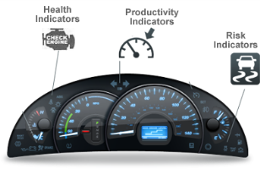
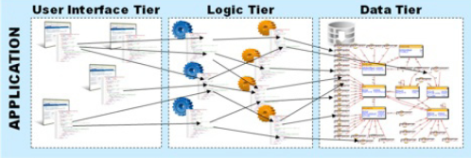


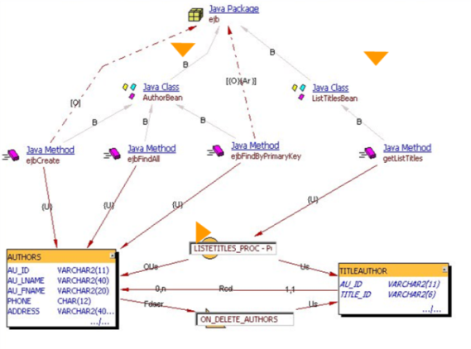



Automated Code and Design Reviews
The Application Intelligence Center
Actionable visibility across the IT organization
Admin
Measurement
Platform
Engineering
Platform
Reports on application health, team performance, benchmarking
Data
AIP Analytical Engine
CFOs, CIOs and VPs
Quality Measurement & Functional Sizing
Software characteristics, cost and risk drivers, ARB, architectural
governance, root cause analysis…
Compliance checks
Code, Architecture and Data Structure Analysis
PMs, QA, Architects
… and feedback & advice on software quality and engineering
Application Source Code
CICS, IMS, COBOL, DB2 z/OS
J2EE, .NET and all Major RDBMS
Web Apps, BI, EAI, C/C++, VB, PB
Siebel, SAP, PSFT, OBS, Amdocs
Development Teams
Notes:
A deeper code analysis is done with the help of another another tool called CAST. This tool runs the scan on the code base configured and generates report around quality indicators like complexity,architecture,programming practices,naming conventions,documentation and size
It provides report on health factors like Performance, Robustness, security , Transferability,changeability and maintainability.
The next slide shows a Health Parameter Based View that CAST offers.

Slide 12
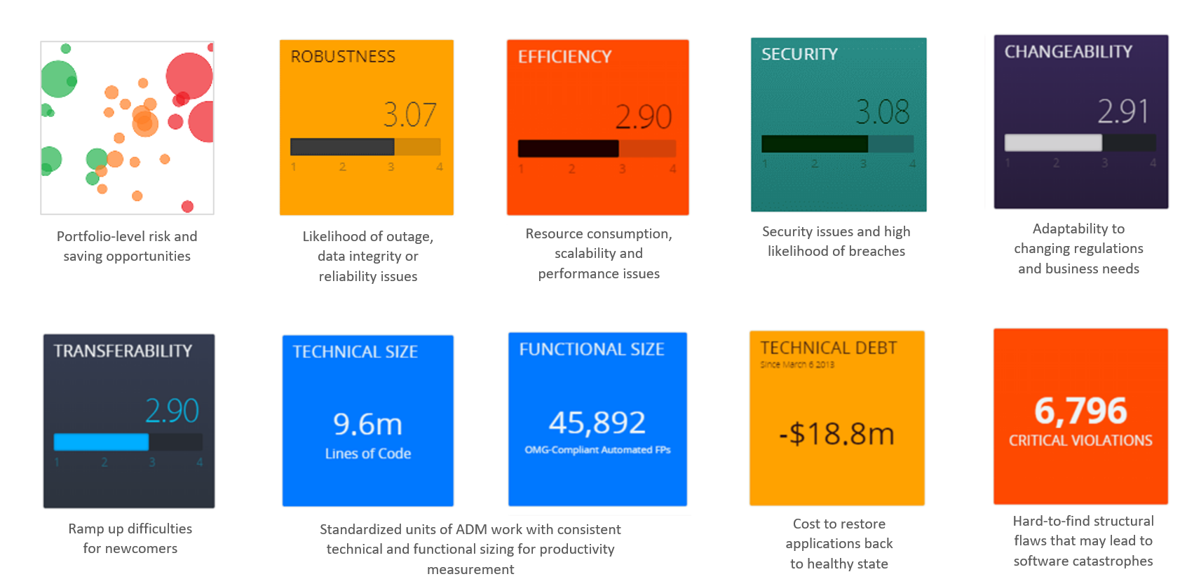
Health Parameter Based View

Slide 13
Project Timelines and Team Structure One Time Activities
High Level Activities | W1 | W2 | W3 | W4 | W5 | W6 | W7 | W8
Energize
Extract
Analyze
Craft
HCL – KPMG Team
Cost Estimates
HCL Team
KPMG Team
Phase 1 (One-Time) | $196,000.00
Phase 2 (On-Going) | TBD
Technical Architect
KPMG Application SMEs
KPMG Functional SMEs
Cost Includes
License cost of one time analysis tool
One-time deep analysis of code base
Access to analysis reports for up to 2 months
Two additional analysis runs within 1 year
Resource costs for the 8 week engagement
Exclusions
License cost of SonarQube or other ongoing code analysis tools
Infrastructure costs
Additional analysis runs
On-going manual code review resource costs
Full-stack Developer
KPMG End Users (Internal)
Code Analysis Tool – Specialist
Datawarehouse BI Architect
Application Architect
Project Manager
Server Side Developer
UI Developer
DB Developer

Slide 14
Assumptions
Prerequisite for start of code review is completion of Knowledge sharing (of Application Architecture, Codebase, business process etc).
Necessary hardware/infrastructure resources to install our tools will be provided
Current development teams will install suggested tools on their own based on instructions provided by HCL
Access to codebase shall be enabled for both onsite and offshore teams.
Access to environment to install our analysis tools shall be provided (will be discussed during the Energize phase).
KPMG is responsible to acquire licenses for ongoing code analysis tools recommended by HCL

Slide 16
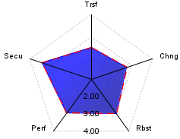
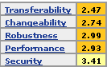
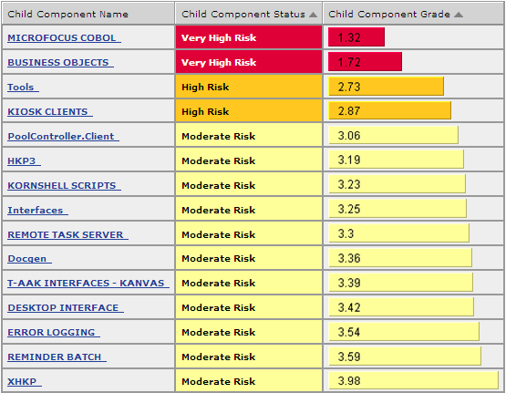
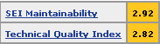
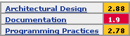
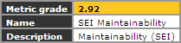
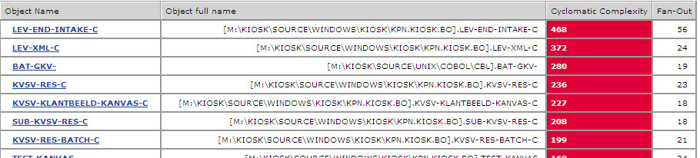
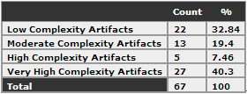
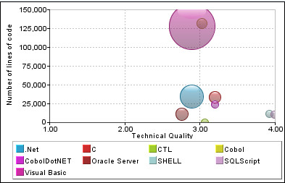
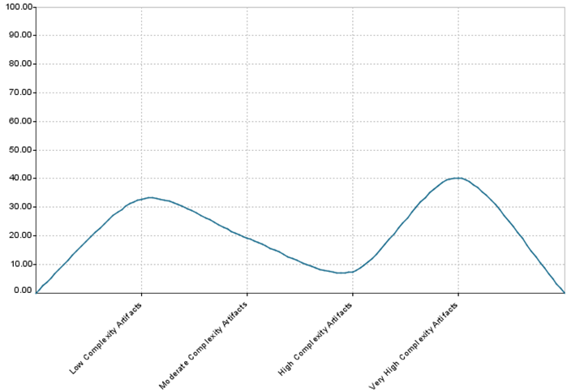
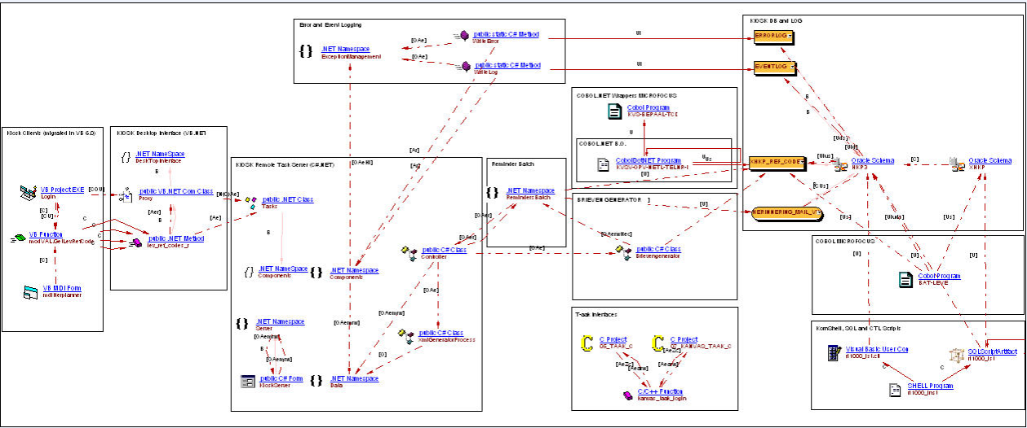
Tier 2 Telco Service Provider: Transition effectiveness & Productivity gain
Client: A US based Tier 2 Telco Service Provider
Objective: Transition 70+ apps in 10 weeks Transition as part of ADM , 70+, mostly business-critical applications ,covering OSS/BSS domain 90% custom applications, covering legacy to 4th generation technologies – VB,VC++,J2EE,.NET,SQLServer, & Oracle, Comverse COTS product
Challenges:First time off shoring by customer Fixed-price contract with stringent 3 months transition timeline Limited support from a combination of in-house/other Sis teams Disparate systems from multiple acquisitions, lack of clear existing or updated documentation , with lot of self-study required
Solution:ASSeT™ + Assess-SMART Complete Application landscape assessment Dedicated seed team completed the assessment in 45 days Analyzed business critical applications using automated tools, identified key areas of risk upfront inside the portfolio and also within the applications Reverse engineered As-is architecture of applications, a key deliverable for customer to assess confidence in the transition Created out of the box technical documentation for secondary KRs for centralized access
Benefits:Quick ROI Reduced transition timelines by 2+ weeks by covering risks upfront effectively Enhanced detailing of documentation by 50% Overall rework rate post -transition was less than 10% in 6m Provided action plans upfront for preventive maintenance to improve Robustness & Performance of applications
Error & Event Logging
LOG DB (Oracle)
lients (VB)
Desktop (VB.Net)
Cobol.NET
Remote Task Server (C#)
Reminder Batch
BO
Microfocus Cobol
Brieven Generator
TAAK interfaces ( C )
KSH, CTL & SQLScript

Slide 17
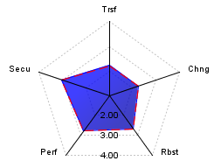
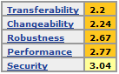
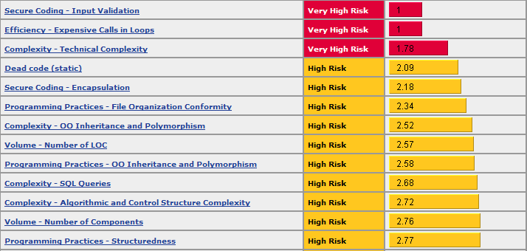
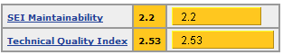
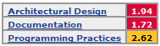
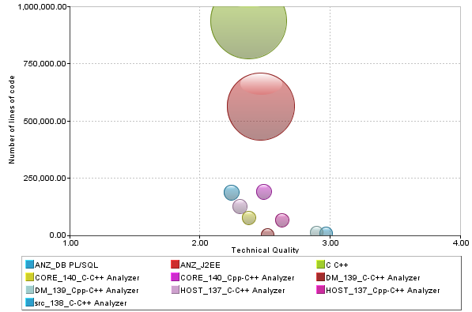
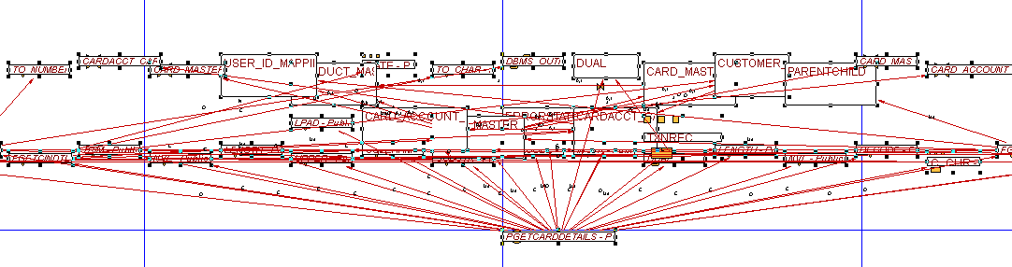
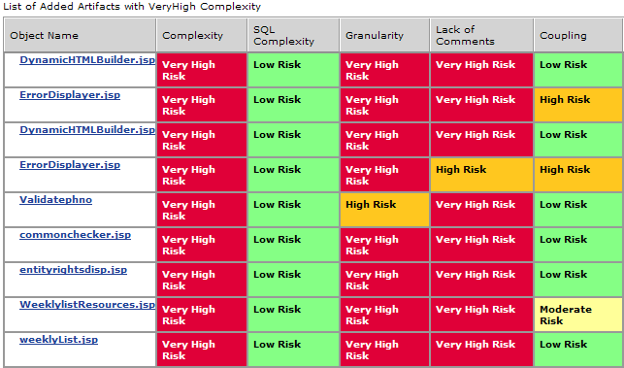
Large Service provider to Banks: Application Transition and consolidation
Client: A large service provider to acquiring and issuing banks, providing complete solution on payment products, processing platforms & processing solutions.
Objective: Transition as part of ADM, 30+ business critical applications, covering credit card clearing domain Consolidate 30 disparate instances of same functional applications in to single instance Landscape includes J2EE, C, C++, Oracle etc
Challenges: SME’s providing little or no information during KT Not much support from current vendor No Documentation for any application Consolidation of 30+ instances in absence of functional and technical documentation and SME support
Solution: ASSeT™ + Assess-SMART Analyzed business critical applications, identified key areas of risk upfront inside the portfolio and also within the application Identified technical and quality variations between instances Helped in selecting base instance, Identified and fixed existing issues to prevent to inherit in target instance. Created technical documentation
Benefits: Quick ROI Assess-SMART capability helped in addressing customer’s key concerns on transition and application consolidation. Helped Transition team to have better understanding of the system and technical documentation Identified critical issues to be fixed for making BAU more efficient and minimizing maintenance cost by using the Dashboard metrics Identified technical variations helped in building solution approach in application consolidation

Slide 18
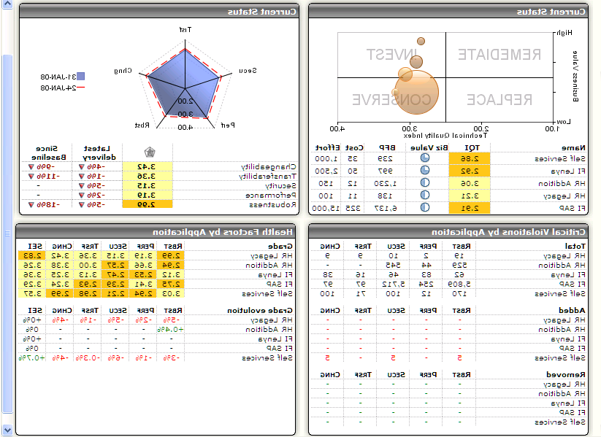
Deep structural analysis of software quality
Quality Metrics Subset
Quality Indicators
Health Factors
Application Quality
SQL Complexity Distribution
Class complexity (Inh. depth)
Complexity
Performance
Class complexity (Inh. width)
Artifacts having recursive calls
Immediate Impact
Method complexity (control flow)
Robustness
Multiple artifacts inserting data on the same SQL table
Architecture
Coupling Distribution
Security
File conformity
Dead code
Application Quality
Structuredness
Programming Practices
Controled data access
Empty code
Modularity
Encapsulation conformity
Naming
Conventions
Inheritance
Package naming
Class naming
Transferability
Interface naming
Package comment
Documentation
Class comment
Changeability
On-Going Impact
Method comment
Package size
Size
Class size (methods)
Maintainability
Interface size

Slide 19
Technology Coverage
Analyzers
Frameworks
Amdocs
ABAP (SAP) Netweaver
ASP.Net
Business Objects, BODI
C
C++
C#
Pro C
CICS
ClearBasic
Cobol
Delphi
Fortan
HTML, XHTML
Hyperion SQR
IBM DataStage
IBM SQL/PSM
IMS
J2EE
Java
JavaScript, Jscript
JCL
JSP
KSH
Natural Adabas
ObjectStar
Oracle Forms
Oracle PL/SQL
Pacbase
PeopleSoft
Perl
PHP
PL1
PowerBuilder
RPG400
Siebel
Slogan
SOA Assistant
SQL Server T-SQL
Sybase T-SQL
Tibco
VB Script
VB.Net
VBScript
Visual Basic
Webmethods
WSDL
XML
…
…
Hibernate
Spring
Struts
Struts Validator
Tiles
JPA
STXX
…
…
…
Universal Analyzer for supporting other languages

